Slide 1

Results Comparison
Name: Zhichao Yang

Slide 2
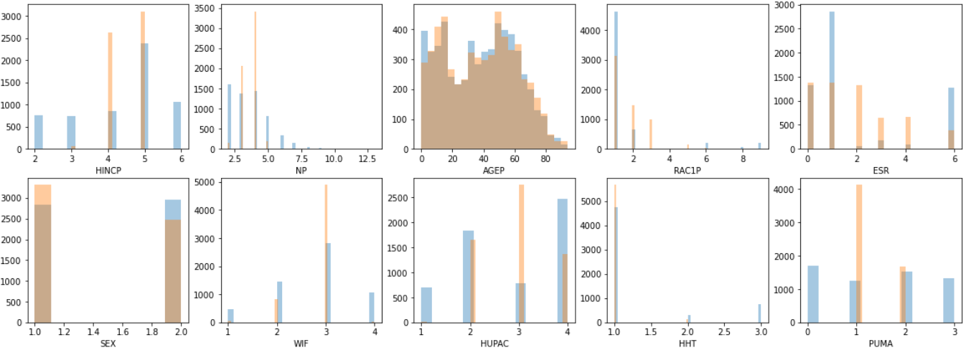
Visualization of the marginals
VAE

Slide 3
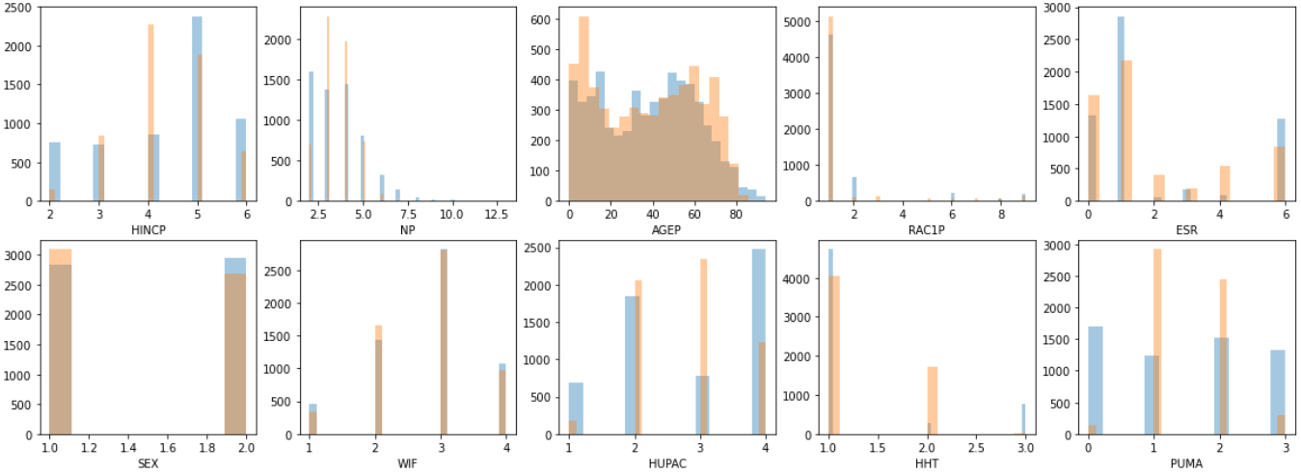
Visualization of the marginals
MedWGAN-GP

Slide 4
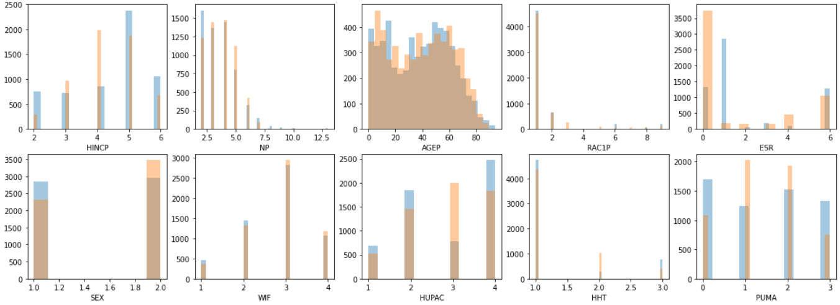
Visualization of the marginals
VAE-GAN

Slide 5
Visualization of the marginals
IPF

Slide 6
Visualization of the marginals
Gibbs sampling

Slide 7
Single column metrics
 | VAE | MedWGAN-GP | VAE-GAN | IPF | Gibbs sampling
HINCP | 0.89 | 0.97 | 0.99 | 0.00 | 1.00
NP | 1.00 | 1.00 | 1.00 | 1.00 | 1.00
AGEP | 1.00 | 1.00 | 1.00 | 1.00 | 1.00
RAC1P | 0.00 | 0.97 | 0.78 | 1.00 | 1.00
ESR | 0.27 | 0.97 | 0.91 | 1.00 | 1.00
SEX | 0.87 | 0.93 | 0.86 | 0.99 | 0.96
WIF | 0.91 | 1.00 | 1.00 | 0.00 | 1.00
HUPAC | 0.78 | 0.87 | 0.94 | 1.00 | 0.96
HHT | 0.91 | 0.51 | 0.84 | 0.99 | 0.97
PUMA | 0.64 | 0.83 | 0.98 | / | 1.00
ST | 1.00 | 1.00 | 1.00 | / | 1.00

Slide 8
Detection metric
VAE | MedWGAN-GP | VAE-GAN | IPF | Gibbs sampling
0.7268 | 0.9072 | 0.7944 | 0.3710 | 0.6040

Slide 9
Dimension-wise prediction
Real /Synthetic | VAE | MedWGAN-GP | VAE-GAN | IPF | Gibbs sampling
HINCP | 0.32/0.28 | 0.32/0.26 | 0.32/0.32 | 0.31/0.28 | 0.32/0.27
NP | 0.41/0.22 | 0.41/0.31 | 0.41/0.38 | 0.40/0.32 | 0.41/0.38
AGEP | 0.04/0.02 | 0.04/0.02 | 0.04/0.02 | 0.04/0.03 | 0.04/0.02
RAC1P | 0.72/0.57 | 0.72/0.67 | 0.72/0.72 | 0.71/0.73 | 0.72/0.71
ESR | 0.80/0.36 | 0.80/0.62 | 0.80/0.23 | 0.80/0.74 | 0.80/0.73
SEX | 0.54/0.49 | 0.54/0.50 | 0.54/0.47 | 0.54/0.54 | 0.54/0.50
WIF | 0.56/0.48 | 0.56/0.49 | 0.56/0.53 | 0.56/0.19 | 0.56/0.49
HUPAC | 0.64/0.41 | 0.64/0.36 | 0.64/0.47 | 0.64/0.53 | 0.64/0.44
HHT | 0.76/0.71 | 0.76/0.57 | 0.76/0.75 | 0.76/0.74 | 0.76/0.65
PUMA | 0.33/0.16 | 0.33/0.15 | 0.33/0.27 | / | 0.33/0.20

Slide 10
Sampling zeros
On 13507 synthetic samples
VAE | MedWGAN-GP | VAE-GAN | IPF | Gibbs sampling
27 | 80 | 90 | / | 0
For IPF, there are 4492 unique samples on 174187 samples(0.026%) and 383 samples in the intersection of the synthetic population and the original population
for 5778 samples in the original population

